Slide 1
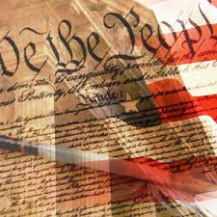
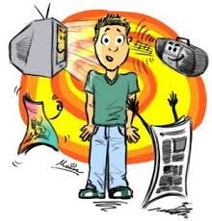

Sociology
Unit 3: Social Institutions

Slide 2
Guys!!!! Can u all pl shut up for sometime

Slide 3
Unit 3 Outline
Unit Q: How are culture and society related to human interaction?
The Family
Education
Religion
The Economy
Politics
The Media
Exam

Slide 4
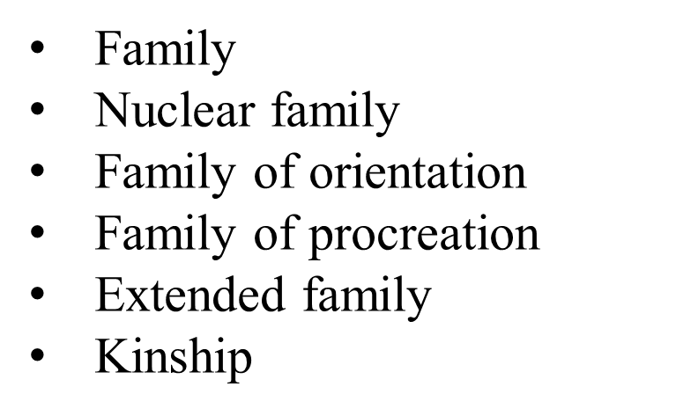

The Family
Q:
According to sociology, what are the functions of a family?
How has the family changed?
Vocabulary
Monogamy
Polygamy
Heterogamy
Dual-earner families
Sandwich generation

Slide 5

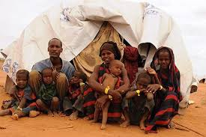
Family
Definition: Group of people who are related by marriage, blood, or adoption and who often live together and share economic resources
The family is the most universal social institution, but what constitutes a “family” varies across cultures.

Slide 6
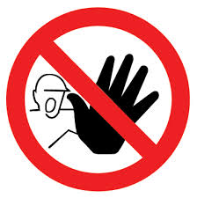

Functions of the Family
Regulation of Sexual Activity
All societies regulate sexual activity to some extent.
Incest taboo is found in every society, but categories of restricted relatives differ across cultures. (relation with siblings, parents, child, grand children) Egypt, India
Socialization
The family is the first agent of socialization, so societies rely on the family to teach the norms of the society.
Parents, siblings, and other relatives serve as the earliest role models

Slide 7
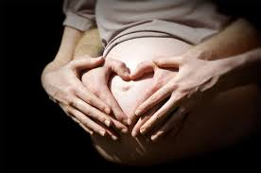

Functions of the Family
Reproduction
Family is the approved social unit for producing members to replace those who die or move away.
Rules are set in place about who can raise children and how children should be raised
Economic and Emotional Security
Family is the basic economic unit.
Family is expected to guide the psychological development of its members and provide a loving environment.

Slide 8
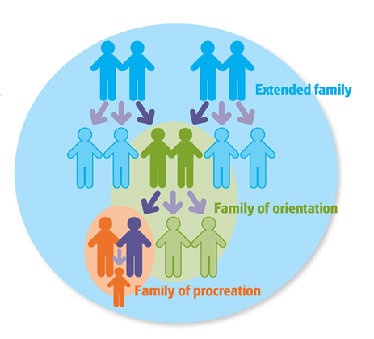
Family Systems
Nuclear family: One or both parents and their children
Family of orientation: The nuclear family into which the person is born or adopted
  When a person marries, a new nuclear family is formed, called a family of procreation
Extended family: Two or more generations
Kinship: Network of people who are related by marriage, birth, or adoption

Slide 9
Family Organization
Family organization depends on the answers to four questions:
How many marriage partners?
  Marriage Patterns
Who lives with whom?
  Residential Patterns
How is family membership determined?
  Descendent Patterns
Who makes the decisions in the family?
  Authority Patterns

Slide 10
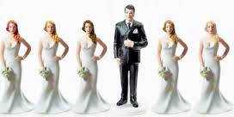
Marriage Patterns
Monogamy: The marriage of one man to one woman
Polygamy: Multiple marriage partners
  Polygyny: One man and multiple women (most common form of polygamy)
  Polyandry: One woman and multiple men (less common)
India- Kinnur region- Himachal Pradesh, mentioned in epic too.

Slide 11
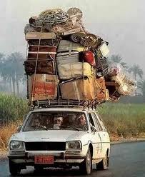
Residential Patterns
Patrilocality: Couple lives with or near husband’s family
Matrilocality: Couple lives with or near wife’s family
Bilocality: Couple decides which parents to live with or near
Neolocality: Couple lives apart from both sets of parents

Slide 12
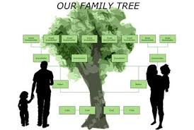
Descendent Patterns
Patrilineal descent: Kinship traced through the father’s family; property passed from father to son
Matrilineal descent: Kinship traced through mother’s family; property passed from mother to daughter
Bilateral descent: kinship traced through both parents; property inherited from either side of the family

Slide 13
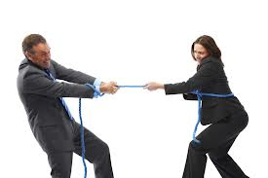
Authority Patterns
Patriarchy: Father holds most of the authority
Matriarchy: Mother holds most of the authority (border of Tibet in the Yunnan and Sichuan provinces)
Egalitarian: Mother and father share authority

Slide 14
Changing Patterns in the U.S.
Dual-earner families: families in which both husband and wife have jobs—became the norm during the late 1900s.
Today day-care centers care for children and fathers are more likely to help with household chores. U.S.A.
Women over 30 accounted now account for 40 percent of births.
The sandwich generation are couples who have babies and elderly parents to care for at the same time. Japan
Time between marriage and first child averaged 15 months in the 1960s.
Voluntary childlessness is the conscious choice to remain childless.

Slide 15
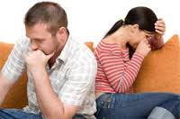

Case Study: Divorce in the U.S.
About 40 to 45 percent of marriages end in divorce.
The U.S. divorce rate is one of the highest in the world.
Age, education level, and race and ethnicity are factors in divorce rate.
Divorce affects women more in economic ways, and men more in emotional ways.
Children of divorced parents often struggle to adjust.

Slide 16

Case Study: Divorce in the U.S.
Four Reasons for Rising Divorce Rate
Laws governing divorce make the process easier than in the past.
Increase in working wives make leaving a husband more economically feasible.
Society attaches less stigma to divorce.
Many people expect more from marriage and are less ready to accept marital problems.

Slide 17
Education
Q: 1. How does education affect social values and norms?
Vocabulary
Education
Schooling
Hidden curriculum
Tracking
Charter school

Slide 18
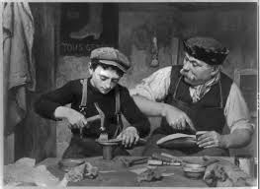

Education
Definition: a system consisting of the roles and norms that ensure the transmission of knowledge, values, and patterns of behavior from one generation to the next.
Schooling is formal education, which involves instruction by specially trained teachers who follow officially recognized policies.

Slide 19
Sociological Perspectives
Functionalist view: Studies the ways in which education aids society
Conflict view: Studies the ways in which education maintains the imbalance of power in society
Interactionist view: Studies the face-to-face interaction of the classroom.

Slide 20


Functionalist Perspective
Teaching Knowledge and Skills
Children must learn the knowledge and skills they will need as adults.
Education generates new knowledge, which is useful in adapting to changing conditions.
Social Integration
Education serves to produce a society of individuals who share a common national identity.
Schools foster social integration and national unity by teaching a core set of skills and values.

Slide 21
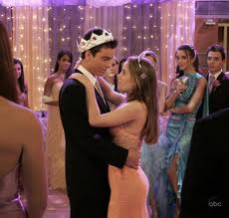

Functionalist Perspective
Transmission of Culture
For societies to survive, they must pass on core values of their culture.
Societies use education to support their communities’ social and political system.
Occupational Placement
Education screens and selects the members of society for the work they will do as adults.
Schools in industrialized countries identify students who show special talents and abilities at an early age

Slide 22

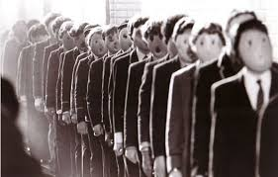
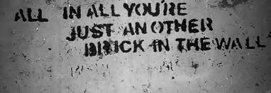

What message is Pink Floyd is attempting to convey through the song “Another Brick in the Wall”?

Slide 23
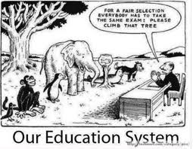

Slide 24
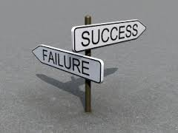

Education: Conflict Perspective
Education serves to sort students into social ranks and to limit the potential of certain individuals and groups to gain power and social rewards.
Students’ achievement or failure tend to reflect existing inequalities.
Tracking
Tracking: Involves the assignment of students to different types of educational programs
Classroom instructions used in the different tracks serve to reproduce the status quo.

Slide 25
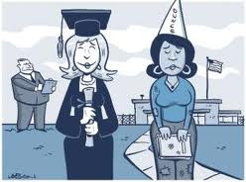
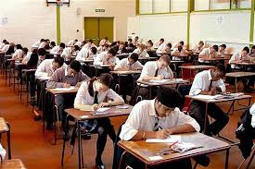
Education: Conflict Perspective
Education and Socioeconomic Status
Opportunities for educational success are distributed unequally.
Higher-status college students outnumber lower-status college students.
Social Control
Schools produce unquestioning citizens who accept the basic inequalities of the social system.
Hidden curriculum: Schools’ transmission of cultural goals that are not openly acknowledged.

Slide 26

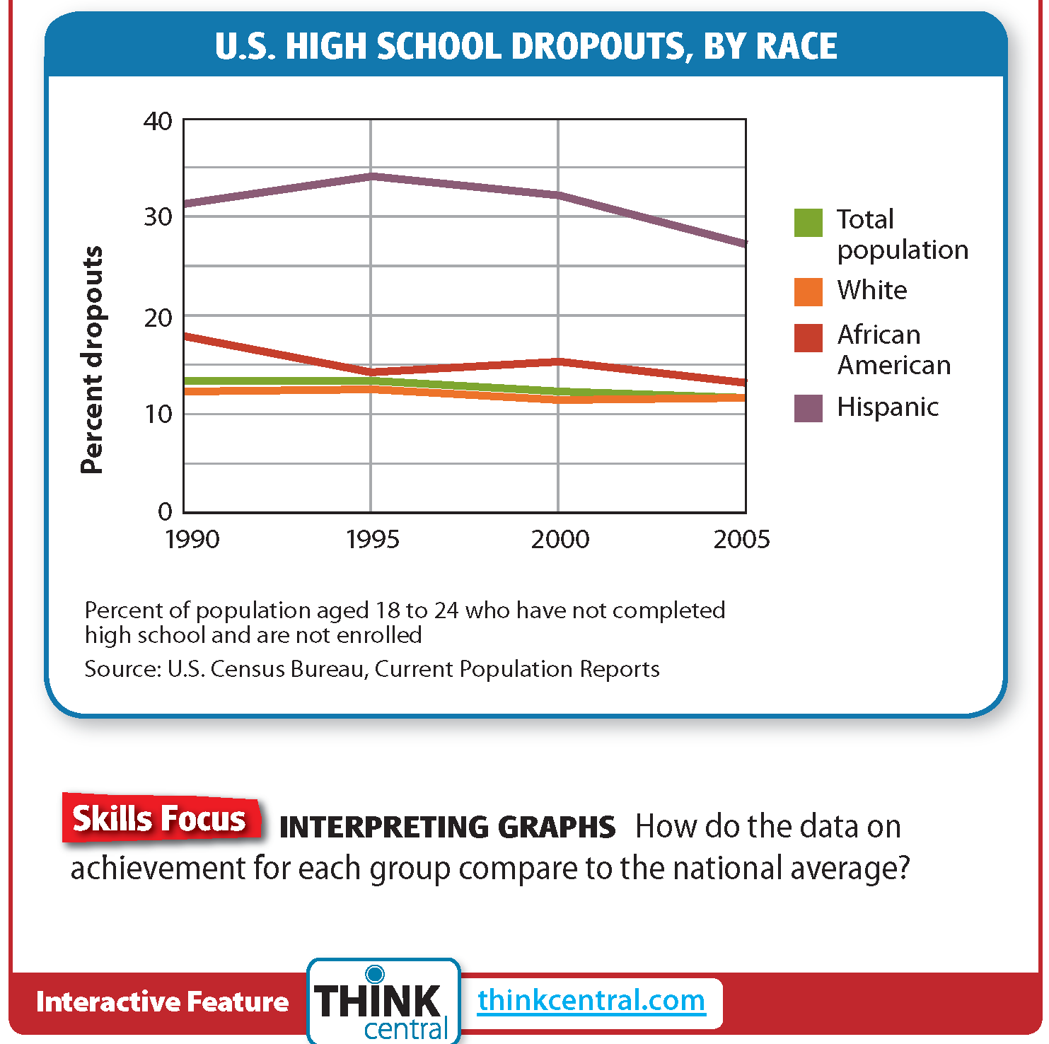
Education and Race

Slide 27

Education: Interactionist Perspective
Student-Teacher Interaction
Students labeled fast learners or slow learners without any data eventually took on the characteristics of the label.
A self-fulfilling prophecy is a prediction that leads to behavior that makes the prediction come true.
When teachers treat students as if they are bright and capable, the students begin to think of themselves in this way, and vice versa.

Slide 28

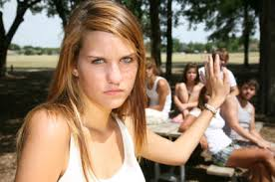
Education: Interactionist Perspective
Interactions among Students
The Coleman Report found that the socioeconomic status of fellow students was the most significant factor in explaining student success.
Peer pressure may be a factor in this dynamic.

Slide 29
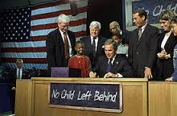

Reform: No Child Left Behind
2001 law with benchmarks for improving schools.
Provided money for schools to improve teaching.
Made standardized test scores the measure of how a school was performing.
Extra emphasis on early reading instruction and teacher preparation.
Although test scores have risen, some claim that higher-order thinking skills have been neglected

Slide 30
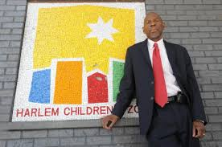
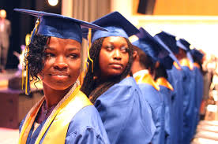
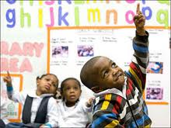
Case Study: Harlem Children’s Zone
What does the Harlem Children’s Zone do to empower its youth and community?

Slide 31
Religion
Q:
1) How does religion affect social values and norms?
Vocabulary
Religion
Sacred
Ritual
Theism
Denomination
Sect
Cult
Secular
Fundamentalism

Slide 32
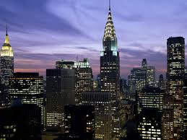
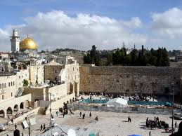
Religion – A Sociological Definition
Profane
Anything that is part of the ordinary world and thus commonplace and familiar.
Sacred
Anything that is part of the supernatural world and that inspires awe, respect, and reverence
Religion: A system of roles and norms that is organized around the sacred realm and that binds people together in social groups

Slide 33

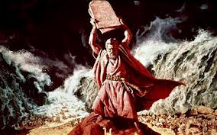
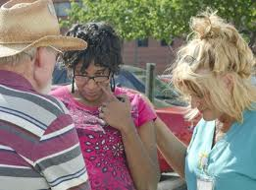
Functions of Religion
Social Cohesion: Encourages the strengthening of bonds among people.
Social Control: Encourages conformity to the norms and values of society
Emotional Support: Provides comfort in times of personal suffering and natural disaster

Slide 34
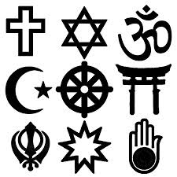
Types of Belief Systems
Animism
the belief in a supernatural
power
Theism
belief in the existence of a
god or gods
Ethicalism
ethical beliefs and behavior generally.

Slide 35
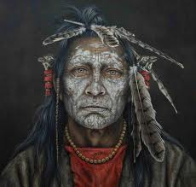
Animism
Belief that spirits actively influence human life
Spirits are contained though out mother nature
Spirits are not worshiped as gods, but are instead seen as supernatural forces that may issue assistance
Example: Shamanism and Totemism

Slide 36
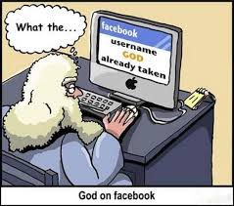
Theism
A belief in a god or gods
Monotheism
  A belief in one god, who is usually the creator and moral authority
  Examples: Judaism, Christianity, and Islam
Polytheism
  A belief in a number of gods.
  Usually centers on one powerful god with lesser gods
  Examples: Hinduism or Greek/Roman Gods

Slide 37

Ethicalism
Based on the idea that moral principles have a sacred quality
A set of principles such as truth, honor, and tolerance serve as a guide to living
Examples: Buddhism, Confucianism, and Shinto

Slide 38
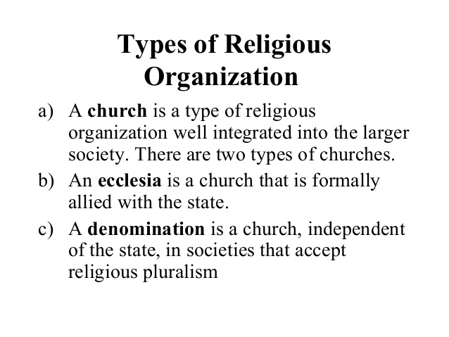
(Ekklesia- a particular body of faithful
People-Greek term for Christian church)

Slide 39
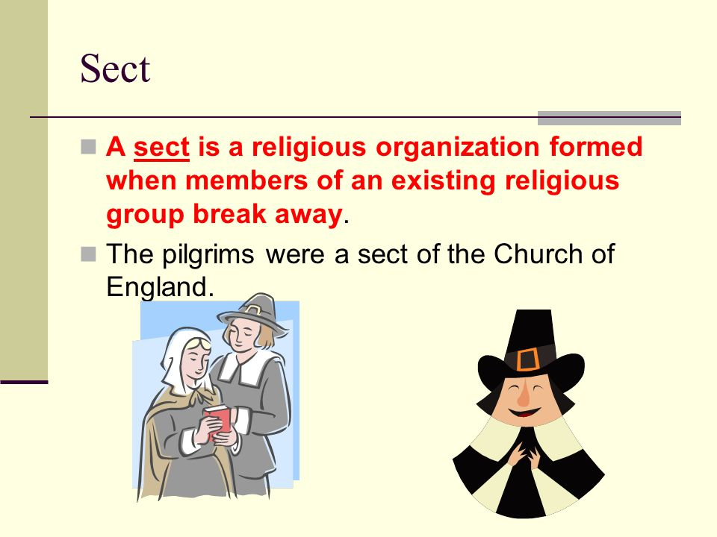

Slide 40
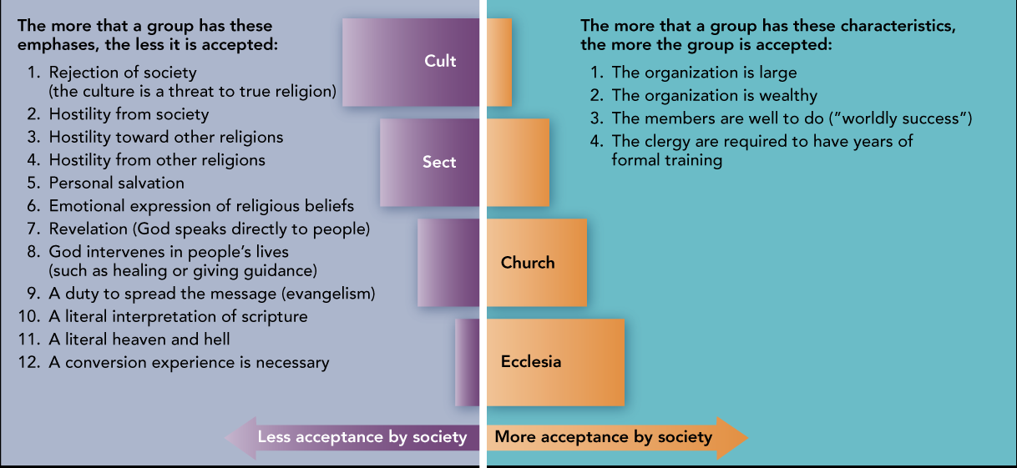

Slide 41
The Economy
Q:
1) How is human interaction affected by economics?
Vocabulary
Factors of production
Primary sector
Secondary sector
Tertiary sector
Capitalism
Socialism
Communism
Law of supply
Law of demand
Laissez-fair capitalism
Corporation
Protectionism
Free trade
Adam Smith
Karl Marx
John Maynard Keynes
Milton Friedman

Slide 42




Economic Institutions and Scarcity
Scarcity = Needs/Wants vs. Resources
What goods and services should be produced?
How should these goods and services be produced?
For whom should these goods and services be produced?

Slide 43

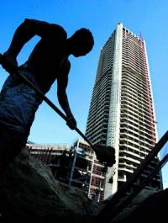


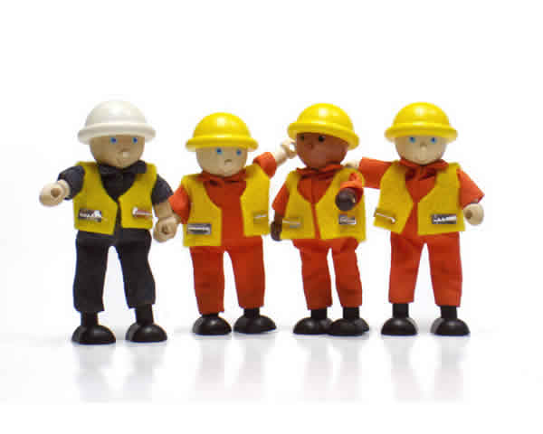



Factors of Production
Raw Materials
Labor
Capital
Entrepreneurship

Slide 44
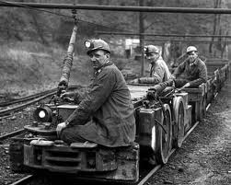
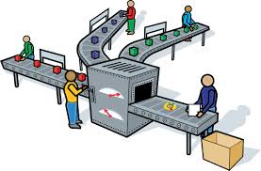

Economic Sectors
Primary Sector: extracting raw material
Secondary Sector: manufacturing goods
Tertiary Sector: providing services

Slide 45
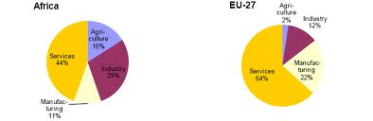
Sectors: Developing vs. The Developed World

Slide 46
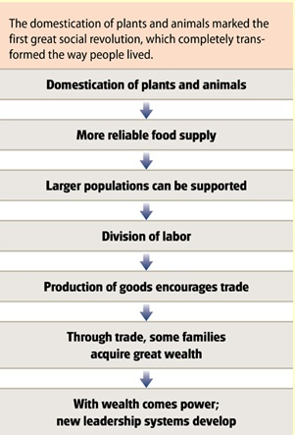
Preindustrial Societies
Food production through the use of human and animal labor is the main economic activity
Subdivided according to technology and method of food production
  Hunter-Gatherer
  Pastoral
  Horticultural
  Agricultural

Slide 47
The Affects of Industrialization
Preindustrial Society
Industrial Society
Emphasis is food production
Economic activities in the home
Produced entire product
Family is the primary socialization and education agent
Social status fairly fixed
Emphasis is manufactured goods
Economic activities in the factory
Division of labor
Education and socialization take place outside the family
Increased potential to change status

Slide 48


Postindustrial society
Emphasis in on the provision of information and services
Standard of living for much of the population as wages increase
Strong emphasis on roles of science and education
Technological advances are viewed as the key to future prosperity

Slide 49
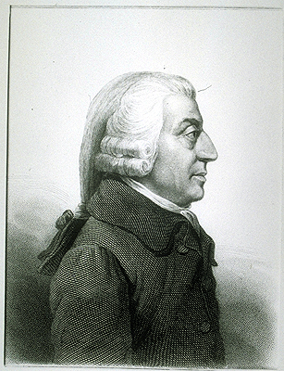
Capitalism and Adam Smith
Economic Laws
Law of Supply and Demand
Price and Profit depends on amount of goods available and the demand for the goods.
2. Law of Competition
Competition would result in the best product possible for the lowest price in an effort to beat the opponent

Slide 50

Laissez-faire
Laissez-faire means “let go”, “allow to do”
Free Enterprise:
  People should be free to conduct in whatever business they choose. They should be able to run business to their greatest advantage. No government interference.
  No restrictive laws should exist.

Slide 51
John Maynard Keynes
In the 1930s, Keynes spearheaded a revolution in economic thinking, challenging the ideas of neoclassical economics that held that free markets would, in the short to medium term, automatically provide full employment, as long as workers were flexible in their wage demands.
He instead argued that aggregate demand determined the overall level of economic activity and that inadequate aggregate demand could lead to prolonged periods of high unemployment.
Keynes advocated the use of fiscal and monetary policies to mitigate the adverse effects of economic recessions and depressions.

Slide 52
Milton Friedman
Friedman's challenges to what he later called "naive Keynesian" theory began with his 1950s reinterpretation of the consumption function. In the 1960s, he became the main advocate opposing Keynesian government policies, and described his approach (along with mainstream economics) as using "Keynesian language and apparatus" yet rejecting its "initial" conclusions. He theorized that there existed a "natural" rate of unemployment, and argued that employment above this rate would cause inflation to accelerate.. Friedman promoted an alternative macroeconomic viewpoint known as "monetarism", and argued that a steady, small expansion of the money supply was the preferred policy. His ideas concerning monetary policy, taxation, privatization and de-regulation influenced government policies, especially during the 1980s. His monetary theory influenced the Federal Reserve's response to the global financial crisis of 2007–08.

Slide 53

Socialism
Description:
  Factors of production owned by the
  government
What to produce?
  Determined by the needs of society
How to produce?
  Central planners decide which items and factories will produce which items. Market competition is not a factor in regulating supply ad demand
For whom to produce?
  Determined by need instead of ability to pay

Slide 54
Politics
Q:
1) How do political institutions exercise power?
2) How are governments influenced by various groups?
Vocabulary
Traditional authority
Charismatic authority
Rational-legal authority
Political party
Interest group
Power-elite model
Pluralist model

Slide 55
Sociological Perspectives
Functionalist
Conflict Theorist
Examines functions of the State
Creation and enforcement of laws
Settling conflict between individuals,
Provision of services
Economic and social policies
Examines how political institutions bring about change
Competition for power
Focus on how political institutions maintain power structure and the struggle that ensues do to power inequity

Slide 56
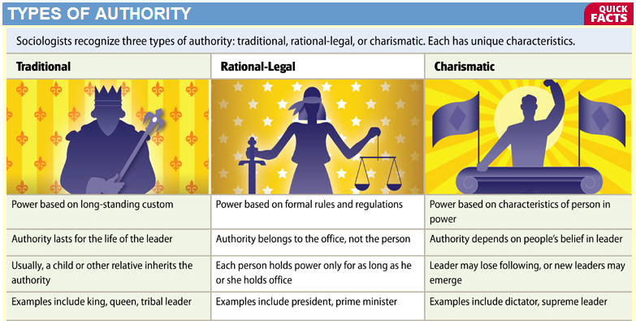

Slide 57


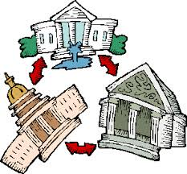

Conditions for Democracy
Industrialization
Access to information
Limits on power
Shared values

Slide 58
The Media
Q: According to sociology, what is the purpose of media?
Vocabulary
Information society
Media convergence
Knowledge-gap hypothesis
Digital divide
Social capital
Spiral of silence
Gatekeepers
Opinion leaders

Slide 59

Media Project
In a group or as an individual, you must choose a medium to present the social institution of the media. Your options include print, online, video, or song. (song would require performance)
Your medium should answer the essential question and cover all of the vocabulary for this topic.
You should consider all criteria from the rubric
Failure to use time wisely will result in loss of class time to complete this project.
The use of humor is allowed but should not be substituted for thoroughness.
The project is due on _________

Slide 60
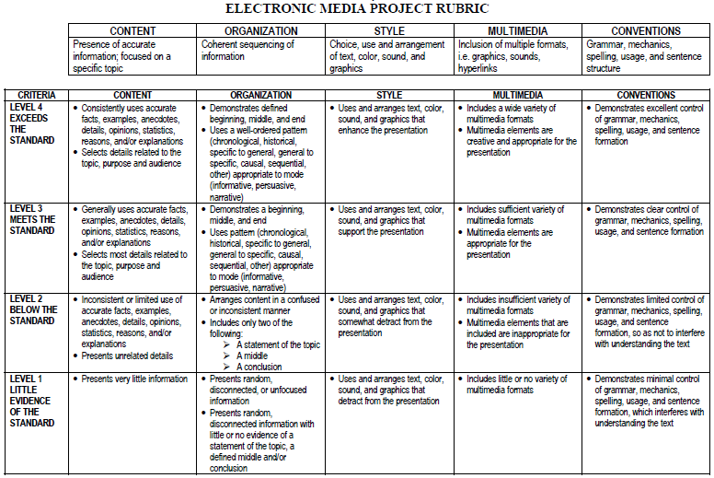

Slide 61
Questions:
Define Sociology. Describe the growth of Sociology as an academic discipline
Today Marriage is no longer considered a sacrament. Comment.
Stereotyping in media of gender and religion leads to ethnocentric views. Comment.
Enumerate the types of marriages that are practiced in societies across the world?
Analyze the role of religion in shaping our society
State the importance of a social institution. Give examples
The economic system in simple and complex societies
Sects and Cults, Dysfunctions of Religion.
Explain the role of Marriage, Family and Polity as institutions, shaping the society.
Write an account outlining the evolution of society from pre-industrial to post- industrial societies?

Slide 62

Study for the
Social Institutions Exam

Slide 63

Lesson Activator
Any questions prior to the Social Institutions Exam?

